Slide 1


JANCY.A
FINAL PROJECT

Slide 2
CHATGPT
WITH MINIMAL RESOURCE

Slide 3
AGENDA
PROBLEM STATEMENT
OVERVIEW
END USERS
SOLUTION
MODELLING
RESULTS

Slide 4
PROBLEM STATEMENT
BUILD A CHATBOT WITH MINIMAL RESOURCE

Slide 5
OVERVIEW
THE AI CONVERSATIONAL ASSISTANT DEVELOPMENT PROJECT AIMS TO CREATE AN INTELLIGENT CHATBOT CAPABLE OF PROVIDING EFFICIENT AND PERSONALIZED ASSISTANCE TO USERS IN VARIOUS DOMAINS.

Slide 6
END USERS
THE END USERS OF A CHATBOT CAN VARY DEPENDING ON ITS PURPOSE AND FUNCTIONALITY.
CUSTOMERS/CONSUMERS
WEBSITE VISITORS
MOBILE APP USERS
STUDENTS/LEARNERS
TRAVELERS

Slide 7
SOLUTION
BUILDING A SIMPLE CHATBOT CAN BE ACCOMPLISHED USING VARIOUS PROGRAMMING LANGUAGES AND FRAMEWORKS.FOR MORE ADVANCED FUNCTIONALITIES LIKE UNDERSTANDING NATURAL LANGUAGE, CONTEXT, OR INTEGRATING WITH APIS FOR MORE DYNAMIC RESPONSES, WE MIGHT NEED TO EXPLORE MORE ADVANCED LIBRARIES OR FRAMEWORKS LIKE RASA, DIALOGFLOW, OR MICROSOFT BOT FRAMEWORK.HERE WE HAVE USED NLTK LIBRARY AND TRAINED THE BOT WITH BASIC RESPONSES.

Slide 8
MODELLING
TRAINING WITH ML ALGORITHMS, NLP MODELS
FINE-TUNING MODEL PARAMETERS
IMPORT REQUIRED LIBRARIES
TRAIN WITH MINIMAL RESPONSES
CREATE CHATBOT

Slide 9
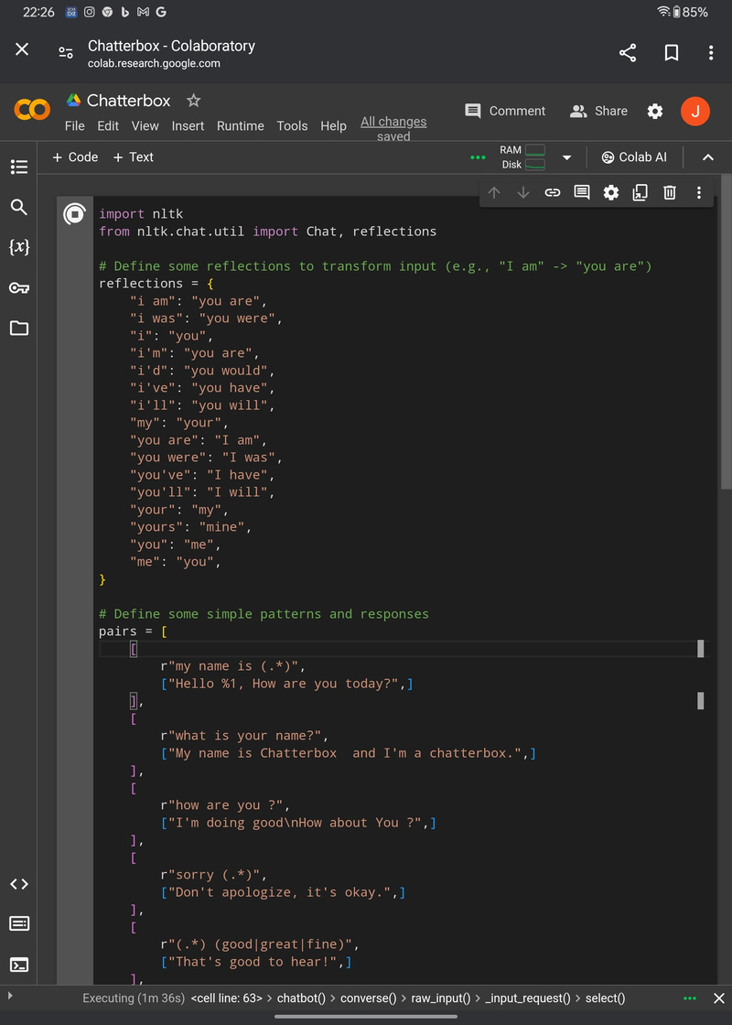
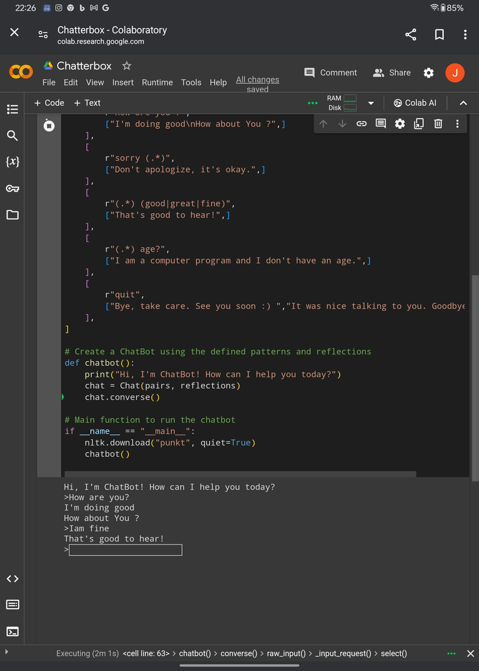
DEPLOYMENT

Slide 10
RESULTS
THE RESULT OF A CHATBOT BUILDING PROJECT IS A FULLY FUNCTIONAL, DEPLOYABLE CHATBOT SOLUTION THAT MEETS THE SPECIFIED REQUIREMENTS AND OBJECTIVES, PROVIDING VALUE TO BOTH THE ORGANIZATION AND ITS USERS.

